Slide 1
Subject: Cloud Computing

Slide 2
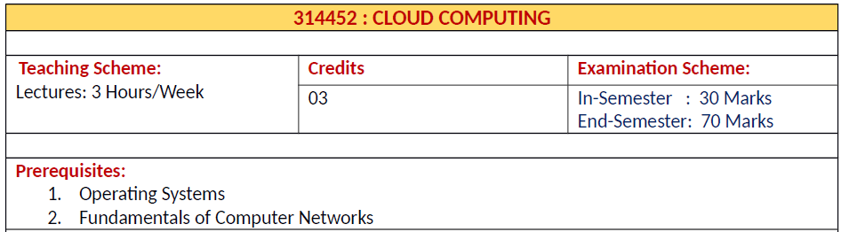
Cloud Computing

Slide 3
Course Objectives
To become familiar with Cloud Computing and its ecosystem
2. Learn basics of virtualization and its importance
3. To be able to do in-depth analysis of Cloud Computing capabilities
4. To give technical overview of Cloud Programming and Services
5. To be exposed to Ubiquitous Cloud and Internet of Things

Slide 4
Course Outcomes
By the end of the course, students should be able to
1 . Understand the need of Cloud based solutions
2. Understand Security Mechanisms and issues in Cloud Applications
3. Have better understanding of effective techniques to program Cloud Systems
4. Understand current challenges and trade-offs in Cloud Computing
5. To find challenges in cloud computing and delve into it to find solutions

Slide 5
Syllabus
Unit I : Fundamentals Of Cloud Computing
Unit II : Virtualization And Common Standards
In Cloud Computing
Unit III : Cloud Programming, Environments And
Applications
Unit VI : Cloud Security And Issues
Unit V: Ubiquitous Clouds And The Internet
Of Things
Unit VI : Future Of Cloud Computing

Slide 6
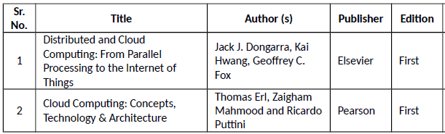
Text Books

Slide 7
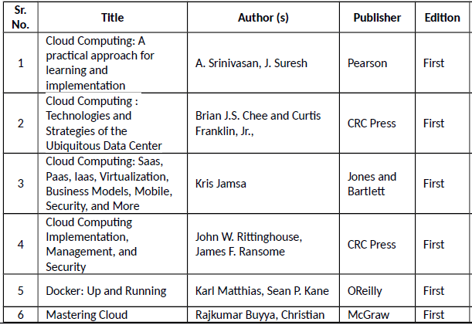
Reference Books

Slide 8
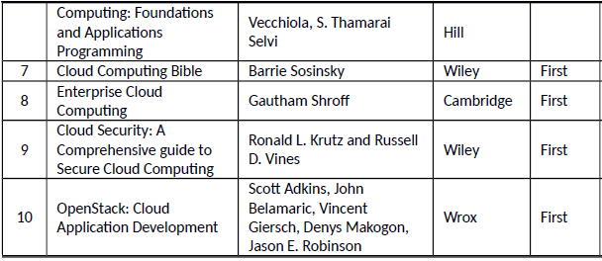
Reference Books

Slide 9
Unit I: Fundamentals Of Cloud Computing
Fundamentals of Cloud
Origins and Influences, Basic Concepts and Terminology, Goals and Benefits, Risks and Challenges, Roles and Boundaries, Cloud Characteristics, Cloud Delivery Models, Cloud Deployment Models, Federated
Cloud/Inter cloud
Cloud-Enabling Technology:
Broadband Networks and Internet Architecture, Data Center Technology, Virtualization Technology, Web Technology, Multitenant Technology, Service Technology

Slide 10
Topic | Books
Basics of Cloud Computing: | Text Book 2: Cloud Computing: Concepts, Technology & Architecture by Thomas Erl et. al, Elsevier Chapter No. 3 and 4
Cloud- Enabling Technology: | Text Book 2: Cloud Computing: Concepts, Technology & Architecture by Thomas Erl et. al, Elsevier Chapter No. 5

Slide 11
Unit II: Virtualization And Common Standards In Cloud Computing
Virtualization
Implementation Levels of Virtualization, Virtualization Structures/Tools and Mechanisms, Types of Hypervisors, Virtualization of CPU, Memory, and I/O Devices, Virtual Clusters and Resource Management, Virtualization for Data-Center Automation
Common Standards:
The Open Cloud Consortium, Open Virtualization Format, Standards for
Application Developers: Browsers (Ajax), Data (XML, JSON), Solution Stacks (LAMP and LAPP),
Syndication (Atom, Atom Publishing Protocol, and RSS), Standards for Security

Slide 12
Topic | Books
Virtualization: | Textbook No. 1: Distributed and Cloud Computing: From Parallel Processing to the Internet of Things by Jack J. Dongarra et. al. Chapters No. 3
Common Standards: | Ref. Book 4 : Cloud Computing Implementation, Management, and Security by John W. Rittinghouse et al. ,CRC Press Chapter No. 7

Slide 13
Unit III: Cloud Programming, Environments And Applications
Programming Support:
Features of Cloud and Grid Platforms, Programming Support of Google App Engine, Programming on
Amazon AWS and Microsoft Azure, Emerging Cloud Software Environments, Understanding Core
Open Stack Ecosystem,
Applications:
Moving application to cloud, Microsoft Cloud Services, Google Cloud Applications, Amazon Cloud Services, Cloud Applications (Social Networking, E-mail, Office
Services, Google Apps, Customer Relationship Management)

Slide 14
Topic | Books
Programming Support: | Textbook No. 1: Distributed and Cloud Computing: From Parallel Processing to the Internet of Things by Jack J. Dongarra et. al. Chapters No. 6
Applications: | Ref. Book 1 Cloud Computing: A practical approach for learning and Implementation by A. Srinivasan, J. Suresh Part 9 : Chapters 28- 32

Slide 15
Unit IV: Cloud Security And Issues
Cloud Security
Basic Terms and Concepts, Threat Agents, Cloud Security Threats, Additional Considerations Cloud
Security Mechanisms:
Encryption, Hashing, Digital Signature, Public Key Infrastructure (PKI), Identity and Access Management (IAM), Single Sign-On (SSO), Hardened Virtual Server Images
Cloud Issues:
Stability, Partner Quality, Longevity, Business Continuity, Service-Level Agreements, Agreeing on the Service of Clouds, Solving Problems, Quality of Service, Regulatory Issues and
Accountability

Slide 16
Unit IV: Cloud Security And Issues
Cloud Security
Cloud Security Mechanism
Text Book 2:
Cloud Computing: Concepts, Technology
& Architecture by Thomas Erl et. al. Pearson
Chapter No. 6 and 10
Cloud issues
Ref2Book Cloud Computing : Technologies and Strategies of the Ubiquitous Data Center by Brian J.S. Chee , CRC Press
Chapter No. 7

Slide 17
Unit V: Ubiquitous Clouds And The Internet Of Things
Ubiquitous Computing
Cloud Trends in Supporting Ubiquitous Computing, Performance of Distributed Systems and the Cloud,
Enabling Technologies for the Internet of Things (RFID, Sensor Networks and ZigBee Technology, GPS),
Innovative Applications of the Internet of Things (Smart Buildings and Smart Power Grid, Retailing andSupply-Chain Management, Cyber-Physical System), Online Social and Professional Networking

Slide 18
Unit V: Ubiquitous Clouds And The Internet Of Things
Ubiquitous Cloud
Cloud- Enabling Technology for IOT
Application of IOT
Textbook No. 1: Distributed and Cloud Computing: From Parallel Processing to the Internet of Things by Jack J. Dongarra et. al.
Chapters No. 9

Slide 19
Unit VI: Future Of Cloud Computing
Future of Cloud
How the Cloud Will Change Operating Systems, Location-Aware Applications, Intelligent Fabrics, Paints, and More, The Future of Cloud TV, Future of Cloud-Based Smart Devices, Faster Time to Market for Software Applications,
Home-Based Cloud Computing, Mobile Cloud, Autonomic Cloud Engine, Multimedia Cloud, Energy Aware Cloud Computing, Jungle Computing
Docker at a Glance: Process Simplification, Broad Support and Adoption, Architecture, Getting the Most from Docker, The Docker Workflow

Slide 20
Unit VI: Future Of Cloud Computing
Future of Cloud
Ref. Book 1 Cloud Computing: A practical approach for learning and Implementation by A. Srinivasan, J. Suresh
Part 10 Chapters 34- 38
Ref. Book 3 Cloud Computing: Saas, Paas, Iaas, Virtualization, Business Models, Mobile, Security, and More by Kris Jamsa, Jones and Bartlett
Chapter No. 20
Docker
Docker: Up and Running by Karl Matthias, Sean P. Kane, Oreilly
Chapter No. 2

Slide 21
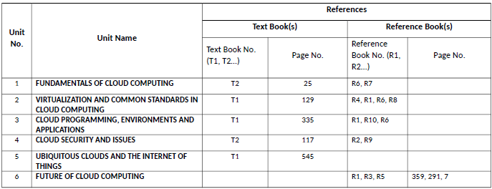
Unit wise References

Slide 22
Thank You

